Slide 1
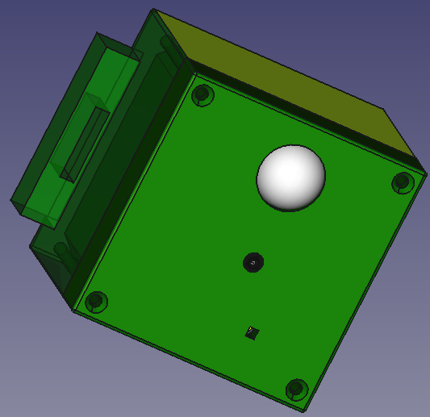
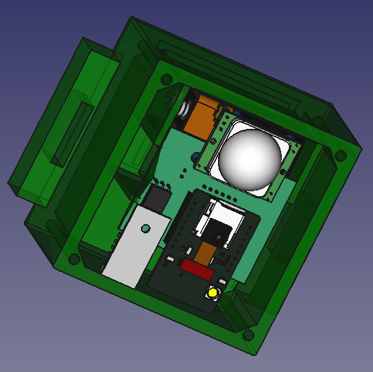
Low-cost trap camera
Knowledge applied
Computer Aided Design
Electronics design and production
3D printing
Embedded programming
Networking and communication
Specifications and capabilities
Waterproof (ABS)
4GB sd memory storage
Environmental conditions sensing
9V portable battery
Wifi connection

